Slide 1


Unemployment and public transport job accessibility
Population Density in GMCA
Case study: Greater Manchester
18th Sept 2024

Slide 2
agenda
Methodology
Datasets
Geospatial Distributions
Travel time to employment centre
Job locations
Public Transport Job Accessibility
Unemployment Rates
Regression Results
Conclusions

Slide 3
methodology
Public transport travel time matrix in R5R
Allow separately for private vehicles
National Travel Survey to derive commuting travel time distribution
Job accessibility index distribution
Fixed effects regression modelling at LSOA level
Other covariates no-car rate, ethnicity, single-parent households, low-qualifications
Instrumental variables to control endogeneity

Slide 4
Datasets
Timetables from BODS (GTFS) and Rail Delivery Group (CIF translated to GTFS)
Socio-demographic data from Census from 2021
Geographic datasets from ONS Open Geoportal
Business Register and Employee Survey (BRES) 2021
National datasets filtered for GMCA

Slide 5
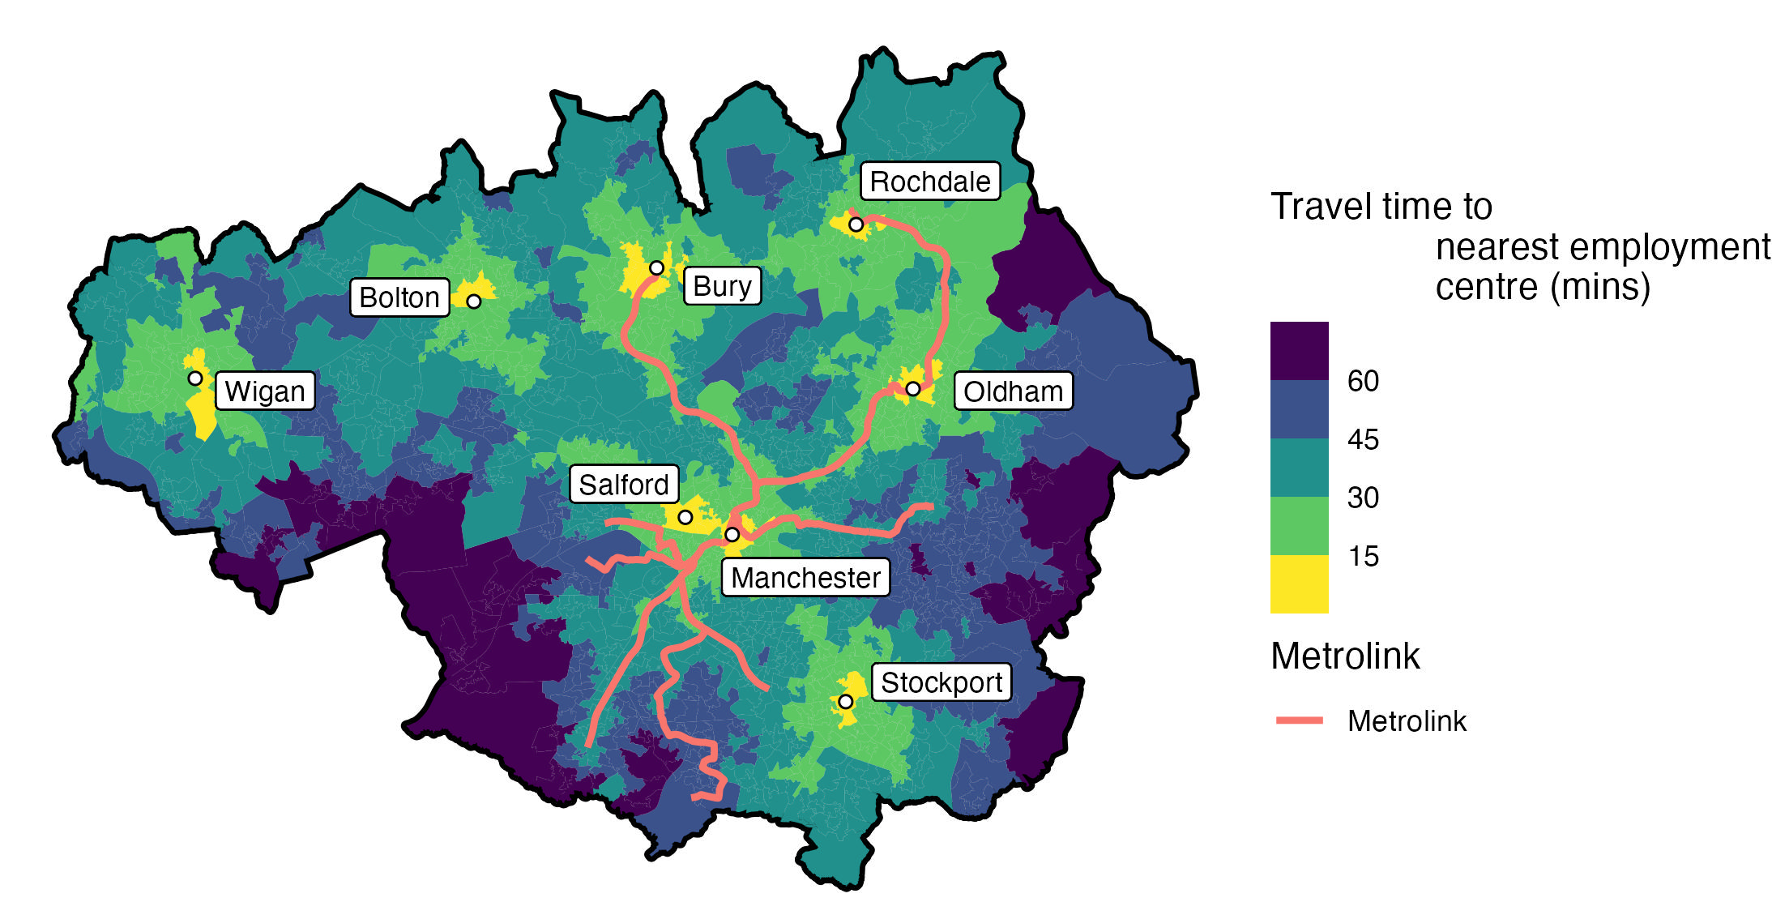
Travel time to local employment centre by public transport
Shows travel time to employment centres is well distributed across regional towns and cities

Slide 6
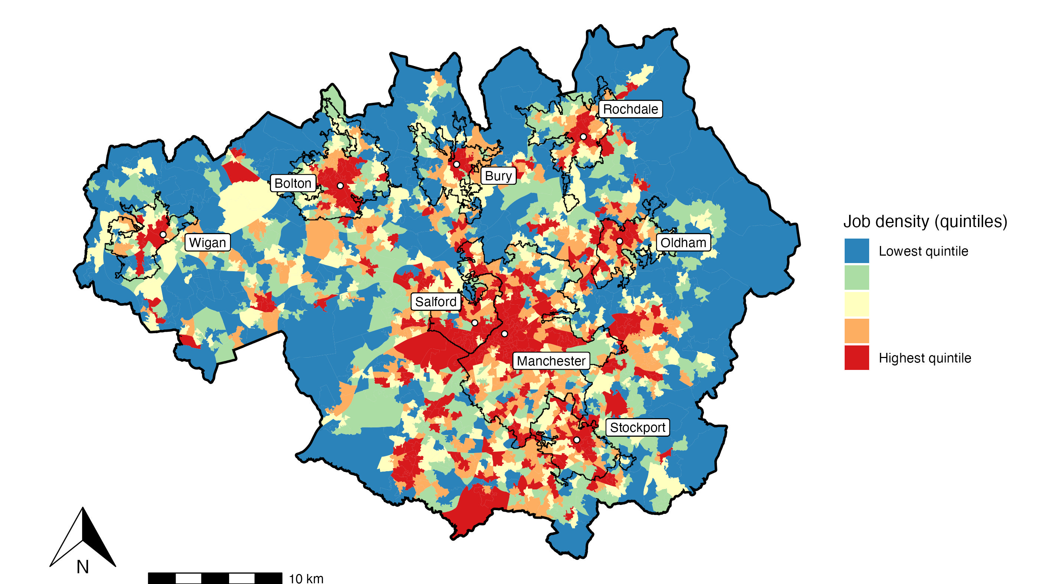
Job locations across Gmca
Showing outlines of major towns and cities as defined by ONS

Slide 7
Demographics of regional towns and cities
 | Jobs | Population | Jobs per person | Unemployment Rate (%)
Salford | 135,550 | 104,009 | 1.30 | 7.33
Manchester | 449,450 | 559,951 | 0.80 | 7.14
Stockport | 72,125 | 104,038 | 0.69 | 4.48
Wigan | 38,790 | 74,354 | 0.52 | 5.20
Bury | 26,180 | 59,523 | 0.44 | 5.78
Oldham | 43,865 | 116,125 | 0.38 | 8.93
Bolton | 64,660 | 174,224 | 0.37 | 7.13
Rochdale | 33,675 | 97,065 | 0.35 | 7.27
GMCA Urban Areas | 864,295 | 560,761 | 1.54 | 6.86
GMCA Suburban Areas | 643,420 | 750,409 | 0.86 | 4.61
GMCA | 1,507,715 | 1,311,170 | 1.15 | 5.58
England and Wales |  |  |  | 4.86

Slide 8
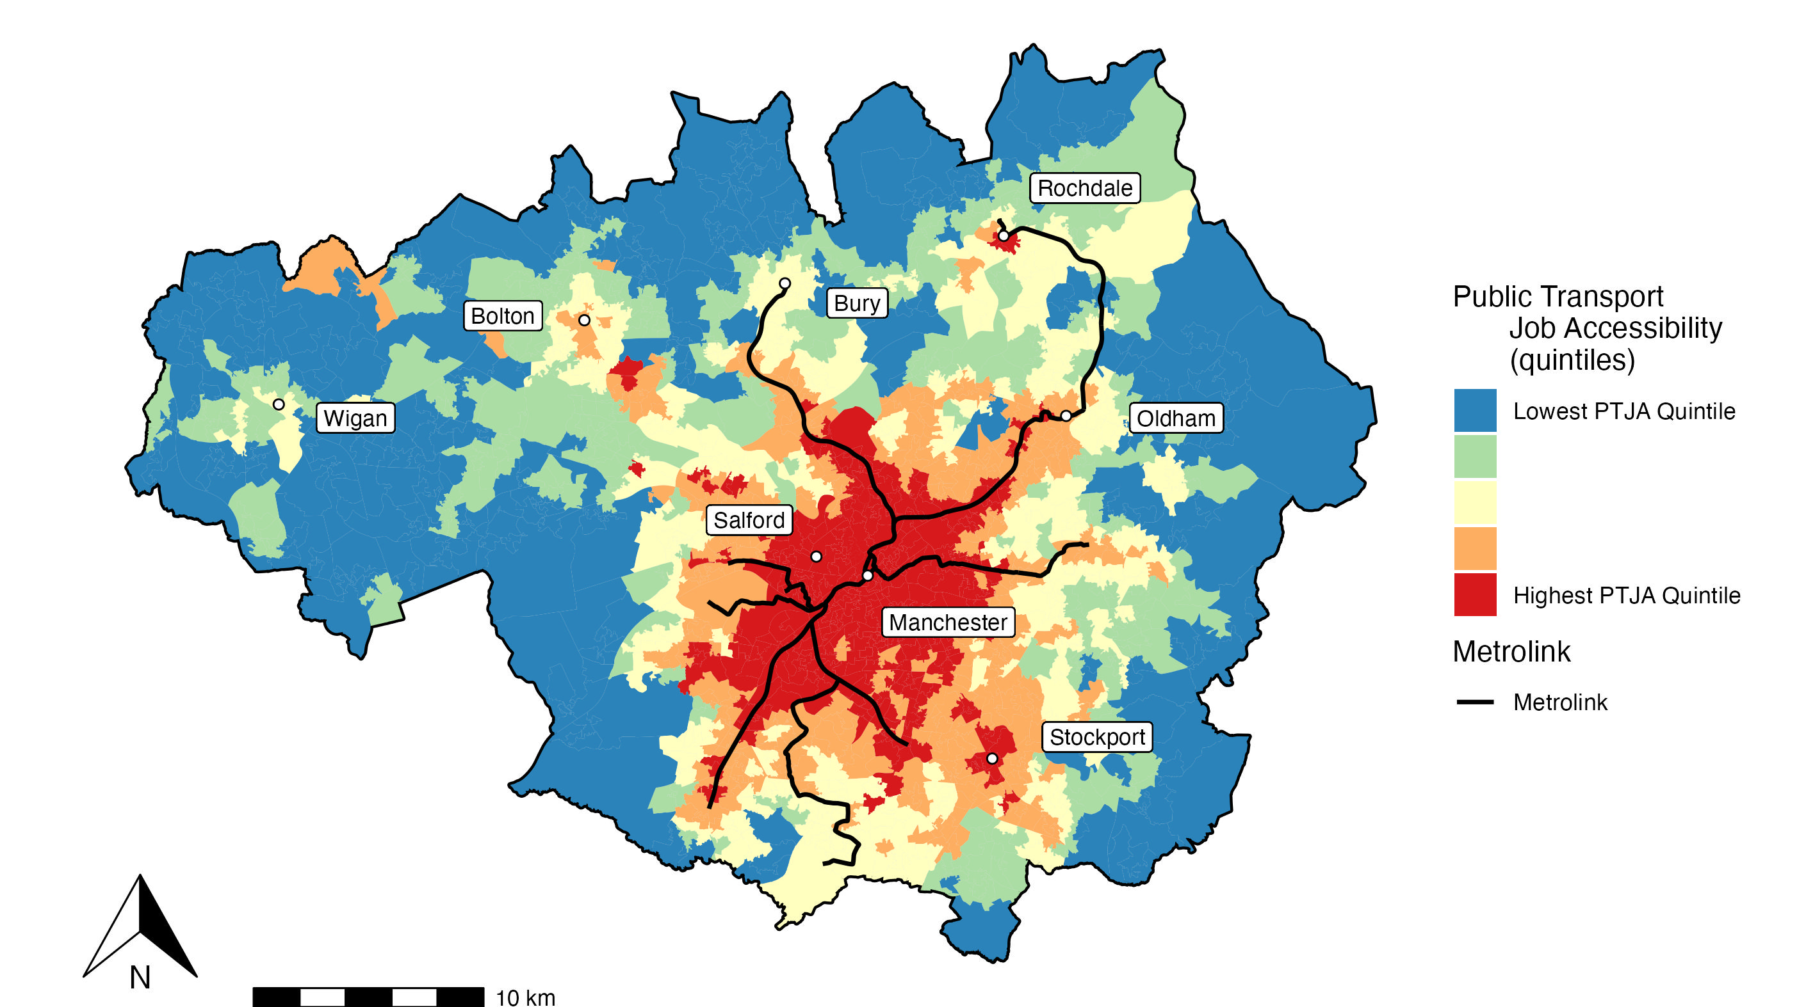
Public transport job accessibility index

Slide 9
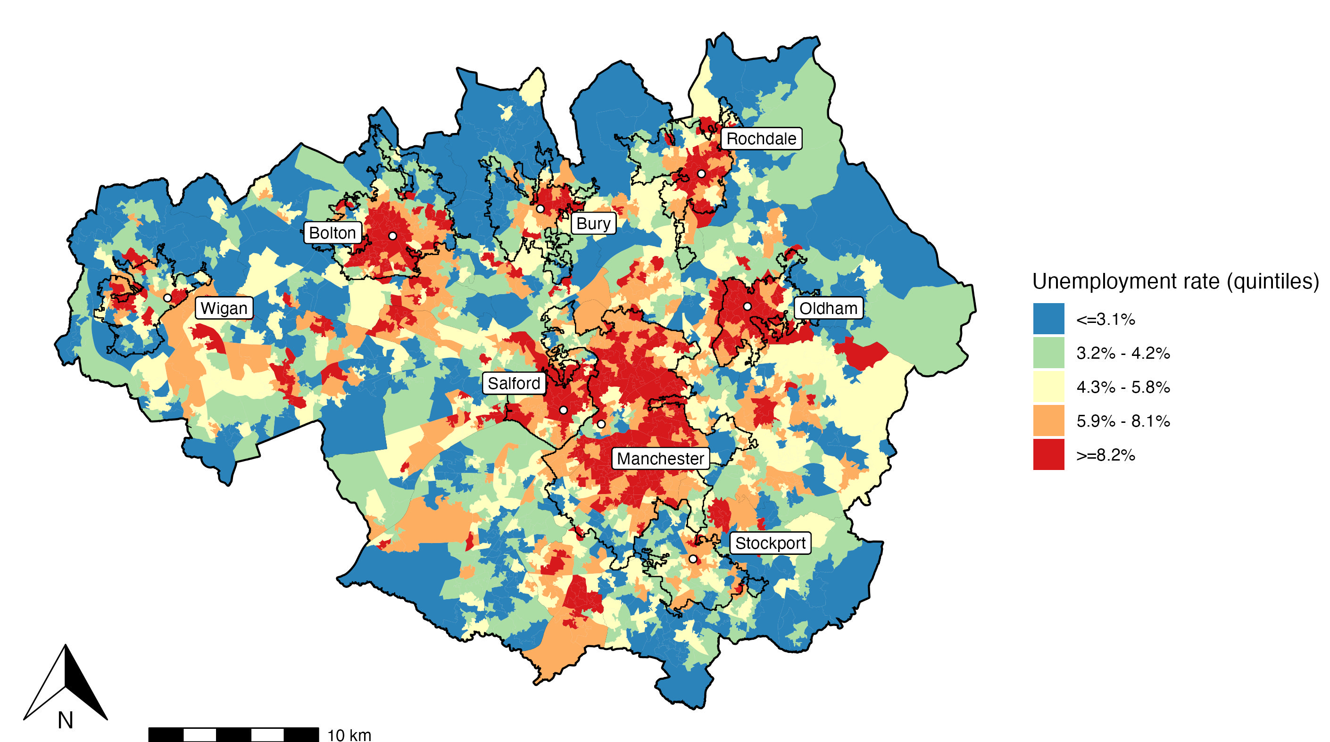
Unemployment rate

Slide 10
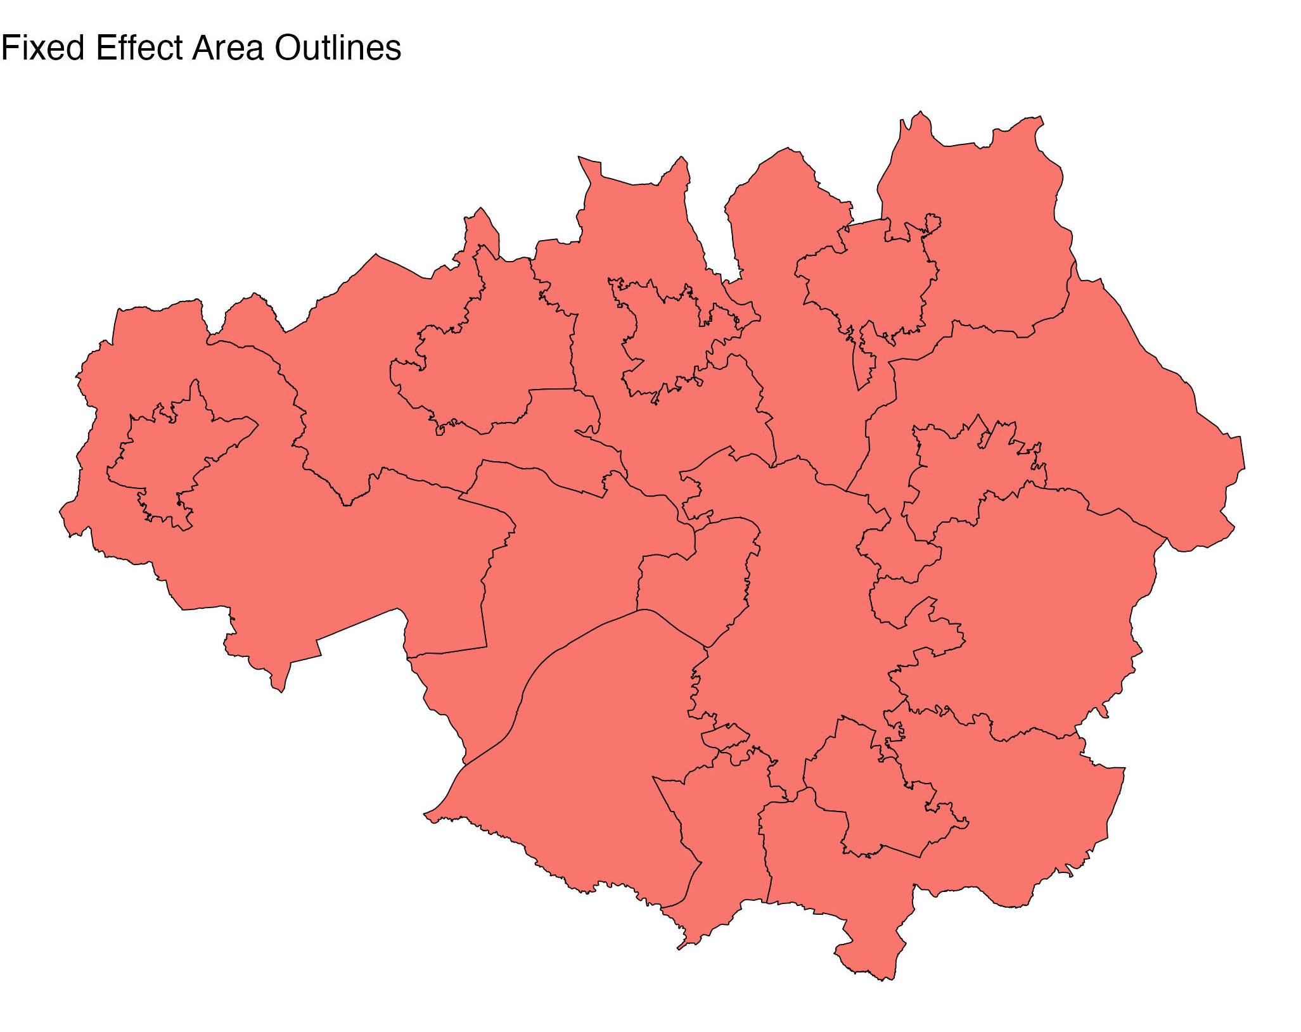
Fixed effects regression
Dependent variable log(unemployment rate) | FE-LL |  | FE-LL | FE-LL-Instrumental Variables
Public Transport Job Accessibility (PTJA) (x10³) | -0.0006 (0.0001) * | -0.0006 (0.0001) * | -0.0006 (0.0001) *
Estimated PTJA - IV (x10³) |  |  |  | -0.0059 (0.0016) *
No-car rate (%) | 0.0219 (0.0008) * | 0.0219 (0.0008) * | 0.0219 (0.0008) *
Estimated no-car rate - IV (%) |  |  |  | 0.0467 (0.0056) *
White people (%) | -0.0078 (0.0004) * | -0.0078 (0.0004) * | -0.0078 (0.0004) * | -0.0124 (0.0019) *
Single-parent households (%) | 0.0194 (0.0017) * | 0.0194 (0.0017) * | 0.0194 (0.0017) * | 0.0059 (0.0037)
Low-qualified rate (%) | 0.0065 (0.0011)* | 0.0065 (0.0011)* | 0.0065 (0.0011)* | -0.0099 (0.0051)
AIC | 6160 |  | 6160 | 1746
Observations | 1,702 |  | 1,702 | 1,702
R² | 0.7771 |  | 0.7771
Residual Std. Error (df = 1679) | 0.2614 |  | 0.2614 | 0.4012
Wu-hausman statistic |  |  |  | 54 ; p-value = 10⁻²³
Standard errors in parentheses. * = p < 0.05

Slide 11
conclusions
Correlation established between PTJA and unemployment rate in GMCA
Jobs are lacking in the regional towns where public transport is not significantly less than Manchester/Salford
Fixed effects modelling approach analysed and considered appropriate
Instrumental variables show endogeneity bias is reducing magnitude of relationship
All models are wrong, but some are useful
Sam Allwood
sam.allwood3@gmail.com
07540 013246

